Slide 1
PRDA-01 Profit Analysis
Multiple Linear Regression & Power BI Dashboard
Prepared By: Dhiraj Pednekar Role: Data Analyst Tools Used: SQL | Power BI |python Academic Year: 2025–2026

Slide 2
Project Objective
• Analyze startup expenditure data
• Identify factors affecting profit
• Build a regression model
• Predict future profit
• Visualize insights using Power BI

Slide 3
Dataset Overview
• 50 Startup Records
• States: California, Florida, New York
• Features: RD Spend, Administration, Marketing Spend, State
• Target: Profit

Slide 4
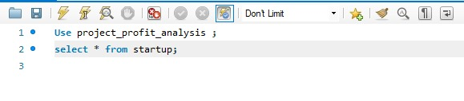
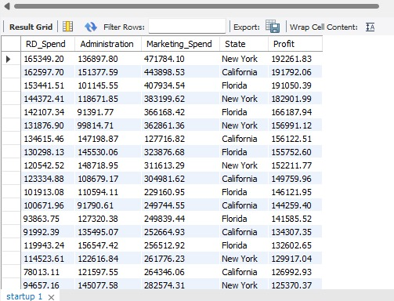
Data Extraction
SQL Query Used:
SELECT * FROM startup;
Data extracted from MySQL and exported to CSV.

Slide 5
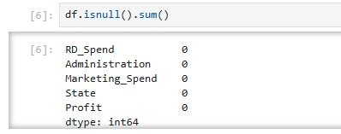
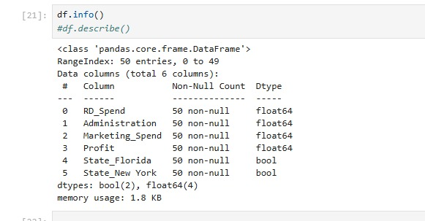
Data Preprocessing
• Missing value check
• Data type verification
• One-Hot Encoding of State column
• Feature and Target selection

Slide 6
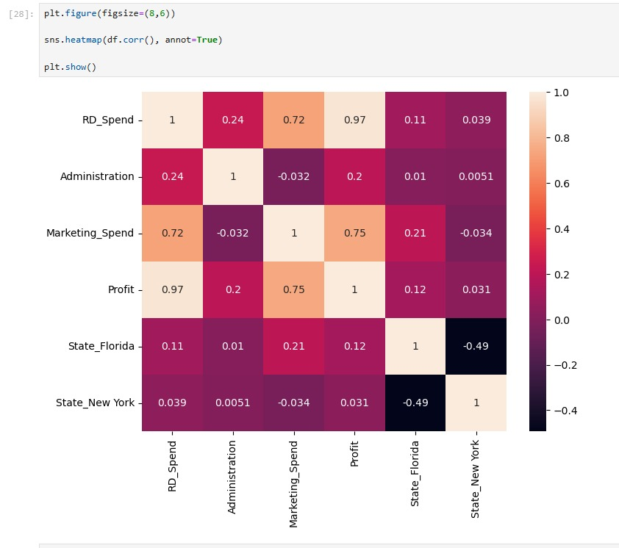
Regression Analysis
Model Used: Multiple Linear Regression
Profit = 54028.04 + (0.8056 × RD-Spend) - (0.0688 × Administration) + (0.0299 × Marketing Spend)

Slide 7
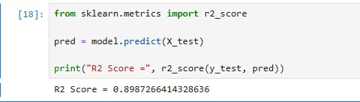
Model Performance
R² Score = 0.8987
The model explains approximately 89.87% of the variation in Profit.

Slide 8
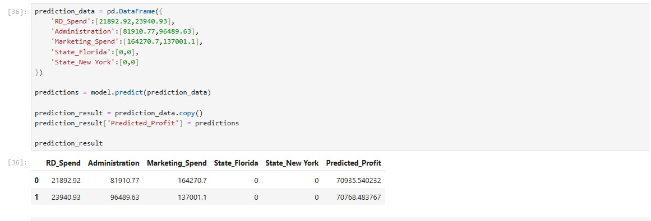
Profit Prediction
Predicted Profit for Record 1: 70,935.54
Predicted Profit for Record 2: 70,768.48

Slide 9
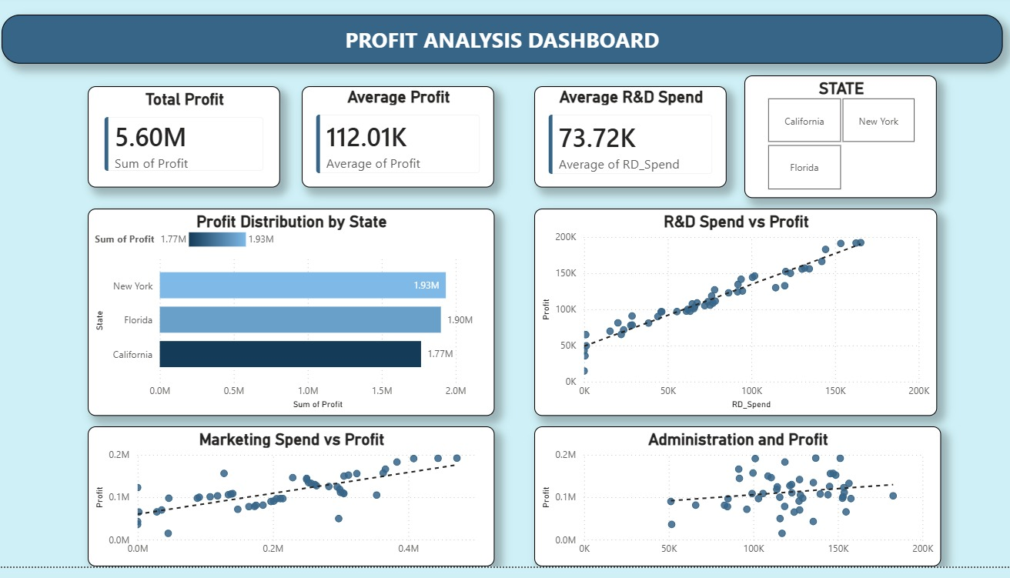
Dashboard

Slide 10
Dashboard Insights
• R&D Spend has the strongest impact on Profit.
• Marketing Spend positively affects Profit.
• Administration has minimal impact on Profit.
• Higher R&D investment increases profitability.

Slide 11
Recommendations
• Increase investment in R&D activities.
• Continue effective marketing strategies.
• Optimize administrative expenses.
• Focus on innovation-driven growth.

Slide 12
Conclusion
The analysis confirms that R&D Spend is the most influential factor affecting Profit. The regression model achieved good accuracy and can support future business decision-making.

